Slide 1

Welcome
Machine learning for a 5G future

Slide 2
Out Lines
What is machine learning (ML)?
What is fifth generation 5G cellular network (5G)?
Internet of thing (IoT).
Why we need machine learning for 5G?
Applications of 5G.

Slide 3
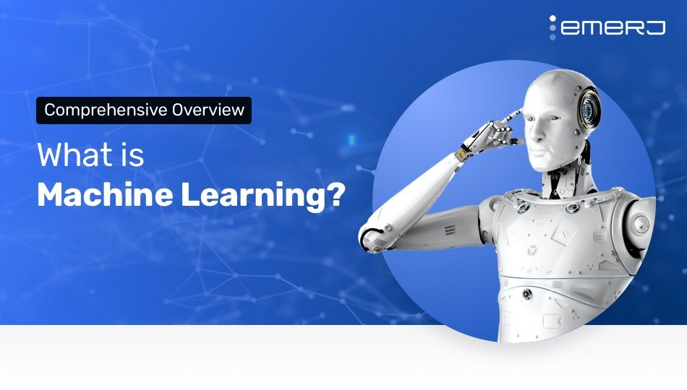
Machine learning is the study of computer algorithms that improve automatically through experience.
It is seen as a subset of artificial intelligence.

Slide 4
We can say that “Machine learning is computer implementation of statistics.”

Slide 5
why we need machine learning?
Machine Learning provides smart alternatives to analyzing vast volumes of data. By developing fast and efficient algorithms and data-driven models for real-time processing of data, Machine Learning can produce accurate results and analysis.

Slide 6
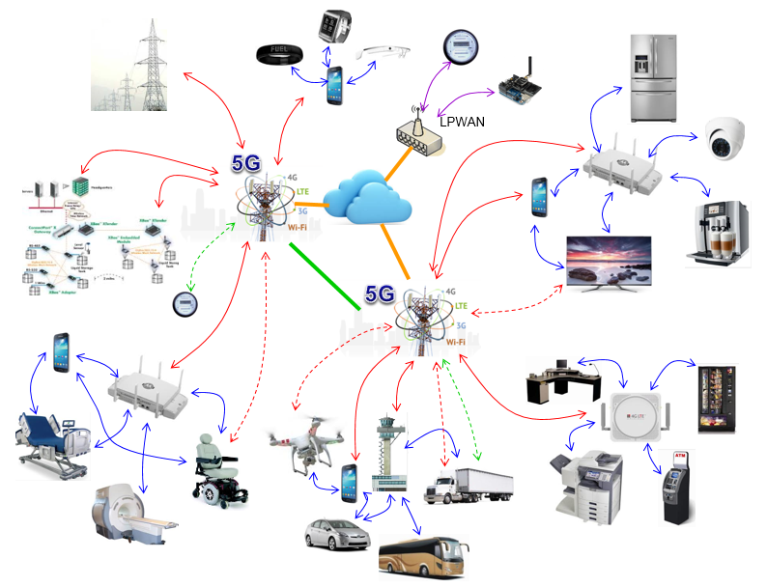
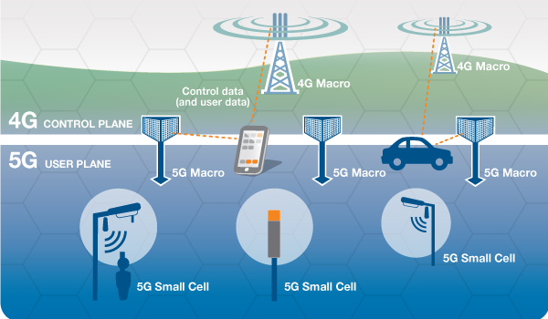
What is 5G ?
5G is the 5th generation of mobile network. Which treat each part of network area as cell.

Slide 7
5G will make world fully Wi-Fi coverage.

Slide 8
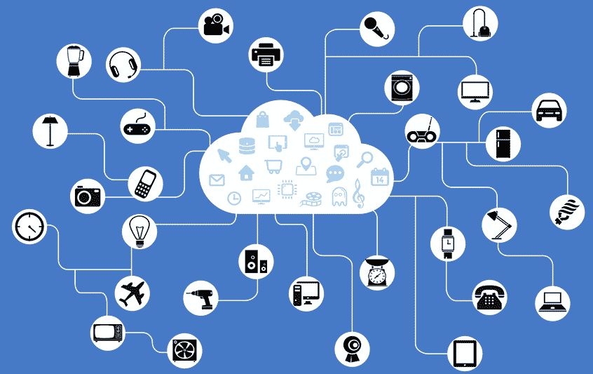
What is internet of things?
The internet of things is billions of connected devices.

Slide 9
Why we need machine learning for 5G?
5G design for internet of things. Internet of things produce high amount of data. To process this high amount of data we need machine learning. Because, it’s not possible to process for any human being.
To make the world more comfortable we need to process the data. After that we will able to predict the actual requirement of each and everyone.

Slide 10
Can we imagine?
Amazon process 40 million product data.
Almost 5 billion videos are watched on Youtube every single day.
9,195 Tweets send in a second.
300 million users use Facebook Stories daily.

Slide 11
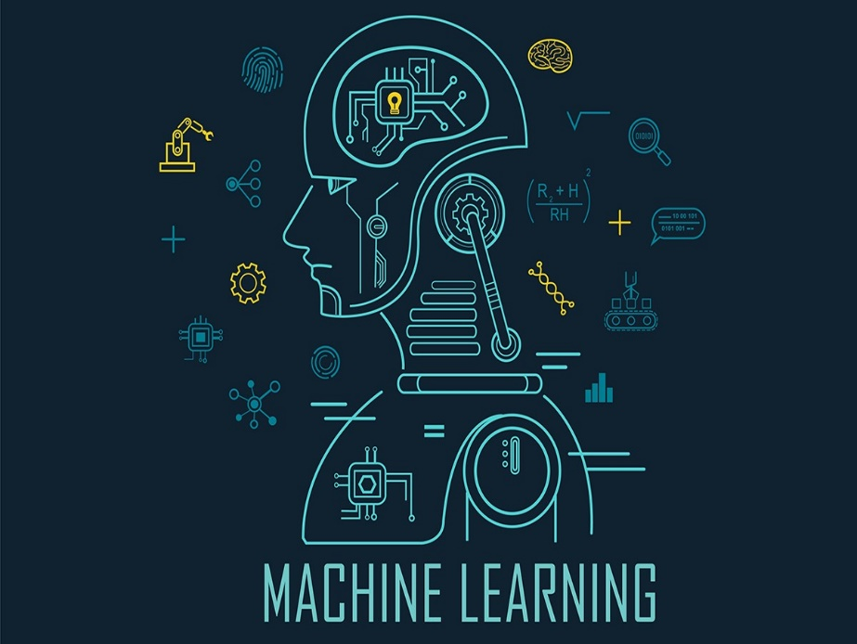
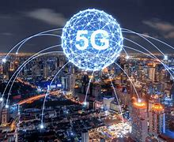
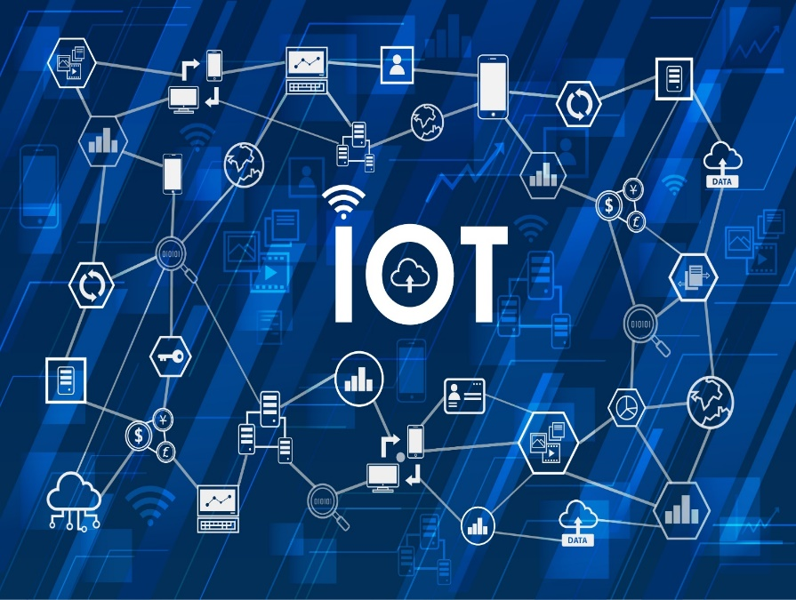
ML IoT 5G
Data process
Connector
Device (Data producer)

Slide 12
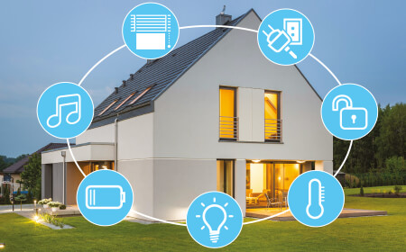
Application of 5G
Smart home

Slide 13

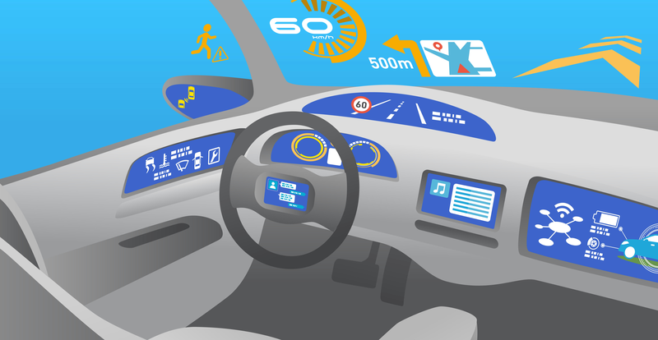
Our dream come to light !
Gamming
Car driving

Slide 14
There is a mater of danger!
There are many kind of network around us. Like-
Mobile network
Radio Network
Wi-Max
Wi-Fi
Walkie-Talkie
Many local network

Slide 15
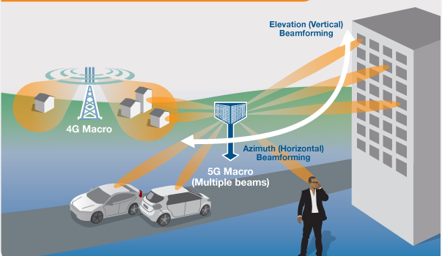

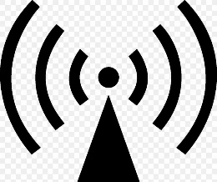

Our surroundings area full of electromagnetic wave

Slide 16
World Health Organization say
To date, and after much research performed, no adverse health effect has been causally linked with exposure to wireless technologies. Health-related conclusions are drawn from studies performed across the entire radio spectrum but, so far, only a few studies have been carried out at the frequencies to be used by 5G.
Tissue heating is the main mechanism of interaction between radiofrequency fields and the human body. Radiofrequency exposure levels from current technologies result in negligible temperature rise in the human body.
As the frequency increases, there is less penetration into the body tissues and absorption of the energy becomes more confined to the surface of the body (skin and eye). Provided that the overall exposure remains below international guidelines, no consequences for public health are anticipated.

Slide 17
Disadvantages of 5G
Obstructions can impact connectivity.
Initial costs for rollout are high.
Limitations of rural access.
Battery drain on devices.
Upload speeds don't match download speeds.

Slide 18
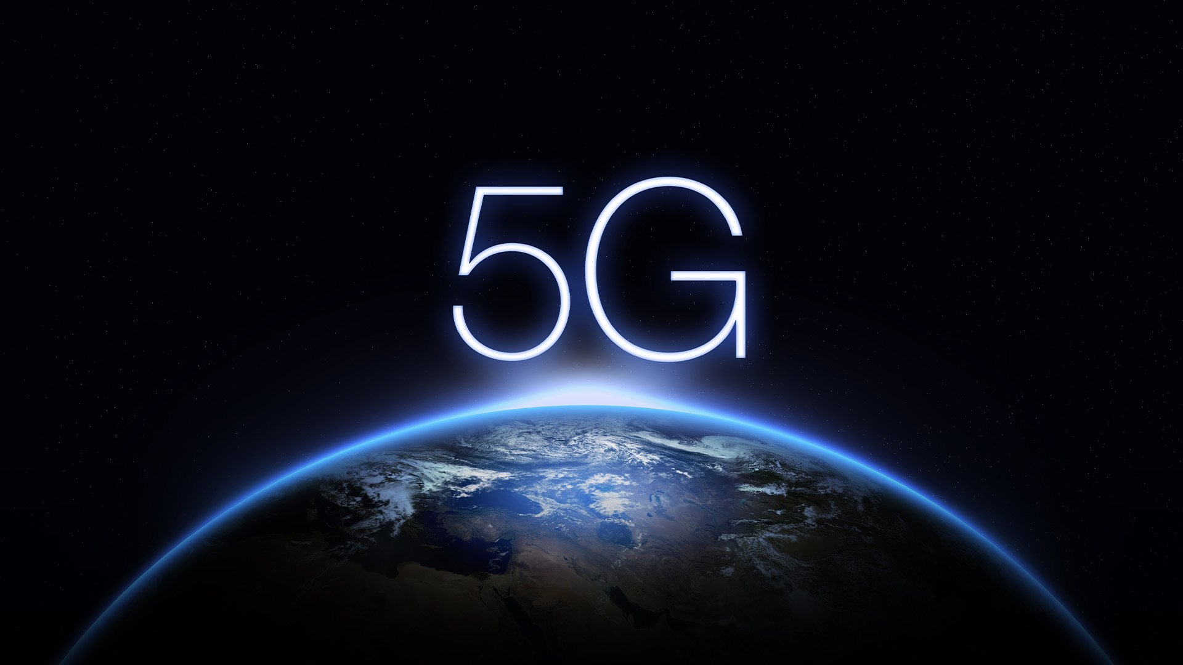
Thank You
Stay Home
Stay Safe
Stay Update
Stay Close

